Slide 1

Automatic Video Dubbing from English to Arabic‏‏

Slide 2
Team Members
Salah Barakat
Mahmoud Hafez
Ali Mosaad
Ahmed Hafez
Mohey Ahmed
Ismael Mahmoud
Elsebaey Mohamed
Supervisor: Dr. Ebrahim Zaghlol

Slide 3
#
Abstract

Slide 4
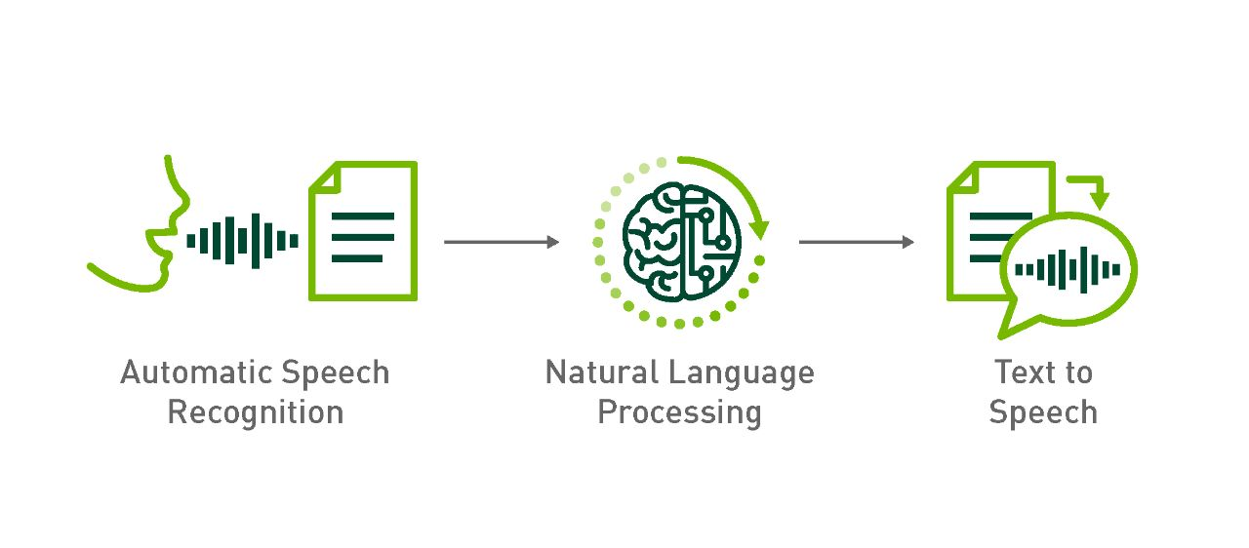
Abstract
1- Objective : Replace original voices in foreign language videos with target audience's language
2- System Components : Speech Recognition, Machine translation, voice synthesis and video analysis techniques
3- Maintaining Synchronization : Consider speech duration, seamless integration without compromising timing
4- Precise Control : Video analysis for prosody and intonation matching original performances

Slide 5

Abstract
5- Benefits :
Enhanced accessibility, engagement, and global distribution of multilingual content.
6- Cultural Relevance :
Synchronized and culturally relevant dubbing for diverse audiences.
7- Visual Integrity :
Preserves visual integrity for cross-cultural communication
8- Conclusion :
Automated video dubbing improves accessibility and engagement while maintaining visual coherence

Slide 6
TABLE OF CONTENTS
01.
04.
Introduction
02.
03.
Objective
Terminology alert
Problem statement
05.
06.
Competitors
08.
07.
UI & demo
Technical Problem Statement
Problem Solution
System Architecture
13.
09.
Conclusion
10.
11.
12.
Tools
Benefits
Future work

Slide 7

01
Introduction

Slide 8

What is Video Dubbing ?
Video dubbing is the process of replacing the original soundtrack of a video with a new soundtrack in a different language while maintaining the same meaning.

Slide 9

Importance of Video Dubbing ?
Salah, an Arabic speaker, faced difficulties learning from an English tutorial due to incorrect subtitles, leading to a lack of concentration and dispersion, highlighting the need for accurate video dubbing to enhance the learning experience.

Slide 10

02
Problem statement
02

Slide 11

Problem statement
Human Approach :
Dubbing involved hiring voice actors and manual alignment.
Challenges:
1- Time-consuming and Expensive.
2- suboptimal lip-sync accuracy.
3- translation quality.
Example :
Time: English Sentence - "Good morning my friend, how are you today?"
Arabic Translation : صباح الخير يا صديقي، كيف حالك اليوم؟
Syllable Count : English - 10 syllables; Arabic - 15 syllables.
Challenge : Adapting the translation to fit the time constraints.
Revised Dubbed Sentence : مرحبا، كيف حالك اليوم؟ (Hello, how are you today?)
“““Balancing translation quality while considering syllable count and timing constraints.”””

Slide 12

03
Objectives

Slide 13

Objectives
1- Localization Simplification
2- Wide Accessibility
3- Automated Lip-Syncing
4- Reduced Manual Efforts
5- Efficient Resource Usage
6- Advancements :
Video-to-video dubbing technology streamlines and improves the Human process.

Slide 14

04
Terminology alert

Slide 15
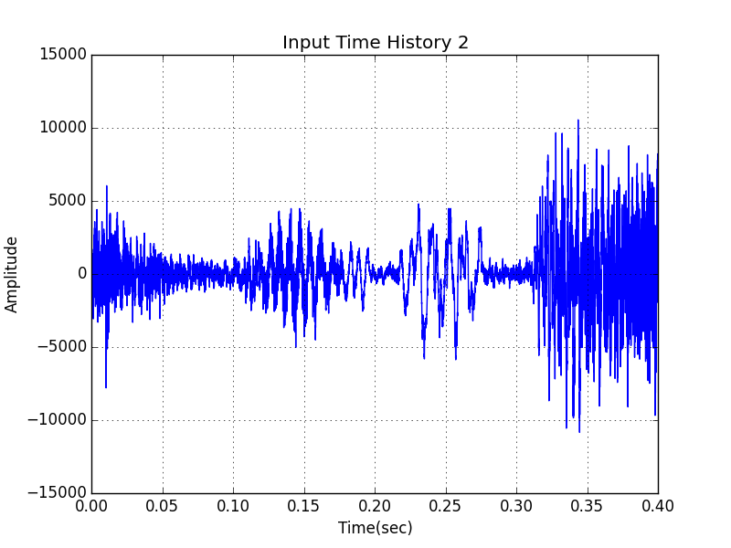
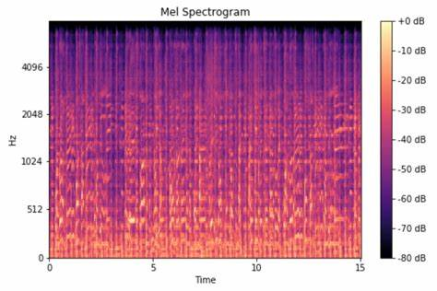
Terminology: Wave
Wave form :
Visual representation of a sound's amplitude over time.
Amplitude :
Measure of a sound wave's intensity or volume.
Mel-Spectrogram:
Visual representation of audio signal’s
frequency content over time.
Frequency Analysis:
Breaks down sound into different pitch components.
Mel Scale :
Non-linear frequency scale that mimics
human perception of pitch.

Slide 16
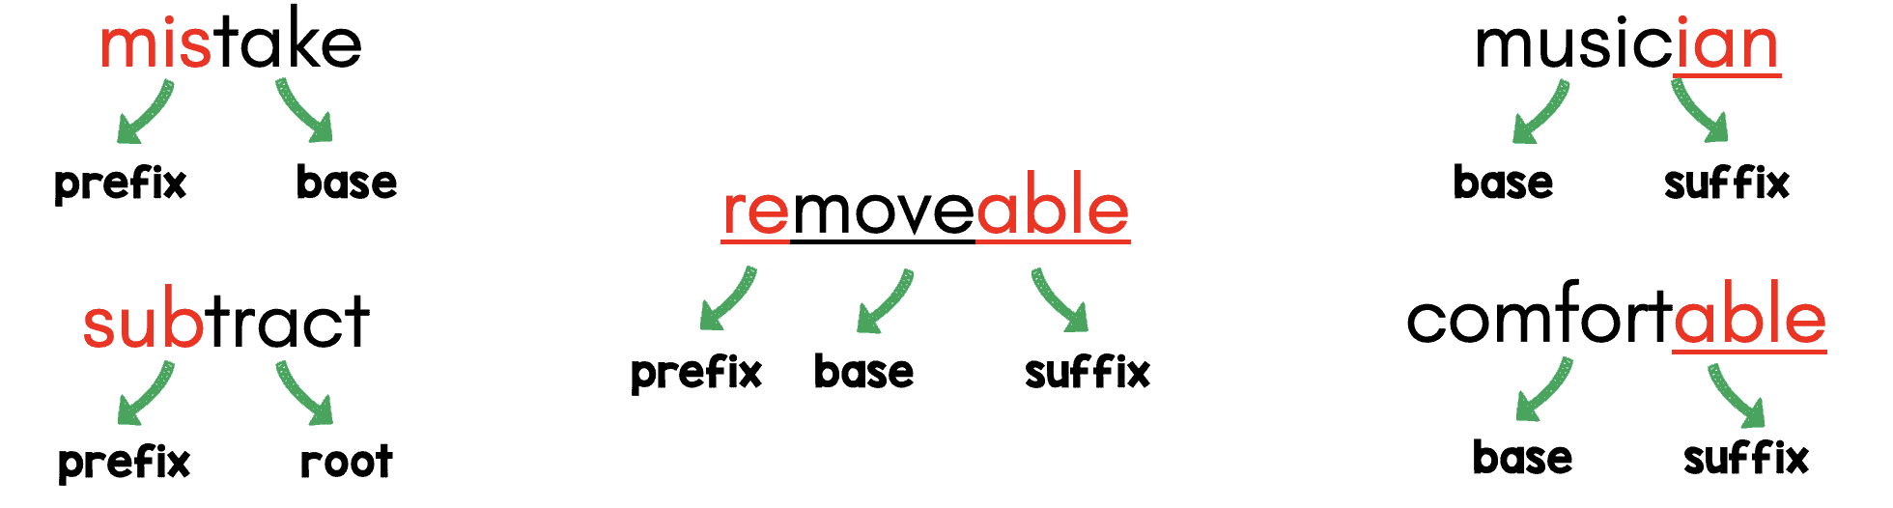
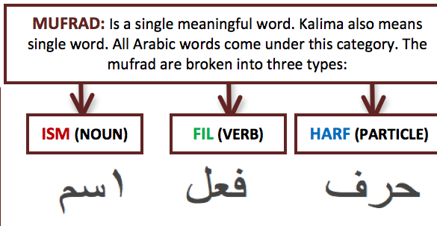
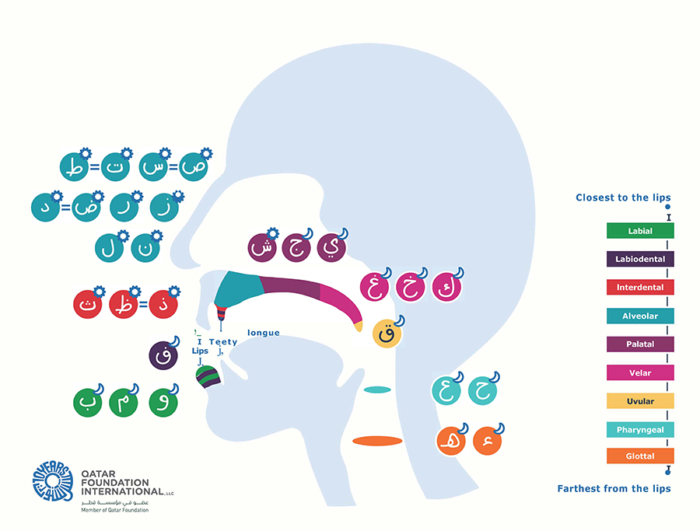
Terminology: Text
Morphology
Syntax
Phonetics

Slide 17
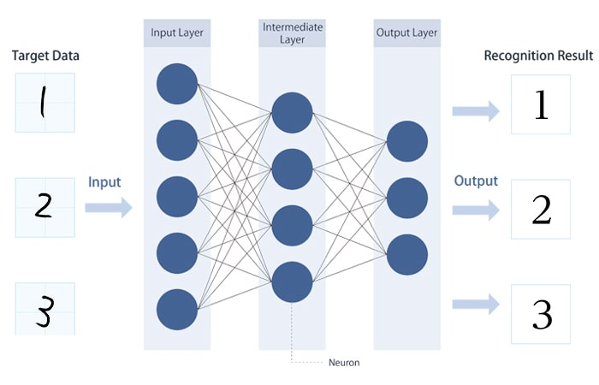
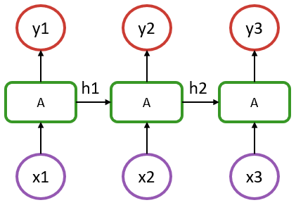
Terminology: Deep learning
Neural Nets :
just a function approximation via matrix multiplication.
Recurrent Neural Networks (RNN) :
Neural network model for sequential data processing, utilizing feedback connections.

Slide 18

Technical Problem Statement
05

Slide 19
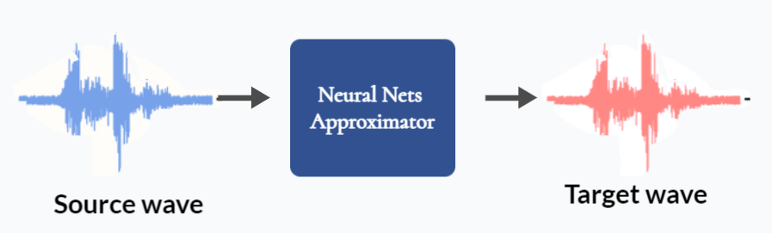
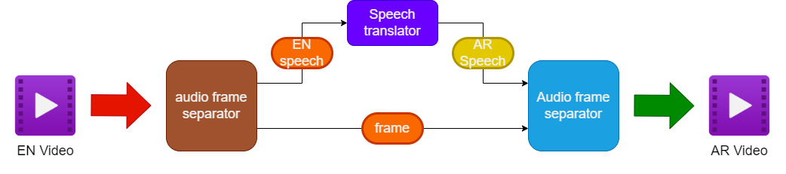
Technical Problem Statement
Task :
Video-to-video can split to Audio-to-audio then synchronization with frame and audio alignment.
In Contrast : Audio-to-audio can be represented with EN Wave to AR Wave conversion using deep learning.

Slide 20
Technical Problem Statement
But also, it’s hardly to directly to train wave to wave system using deep learning:
WHY ?
1- Need large datasets and this not available for English Arabic pairs.
2- Hardly to train directly in Raw wave form because the input size is extremely large.
3- Need large computing power and may be to take months or years to fit the data.

Slide 21

Problem Solution
06

Slide 22
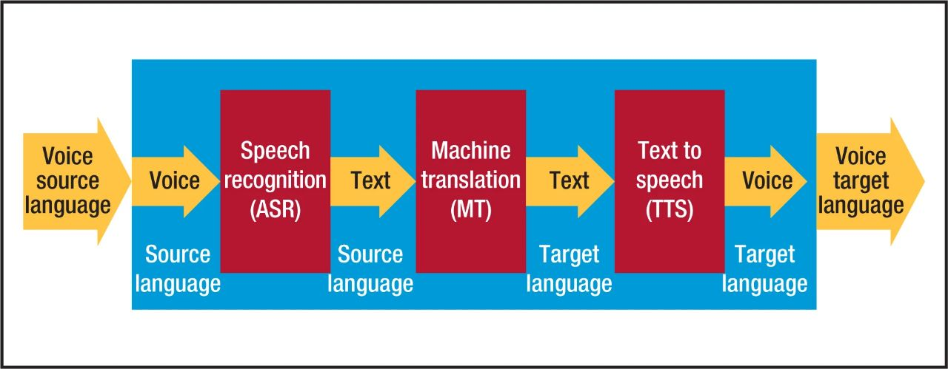
Problem Solution
Narrow AI :
AI systems designed for specific tasks, limited in scope and lacking general intelligence.
Large Model Split: Divide into 3 sub-models, each addressing a specific task.
1- Speech Recognition
2- Machine Translation
3- Text to Speech

Slide 23

Alert
It’s hardly to train the 3 models of ASR, MT and T2S
from Scratch Because it needs large compute Power.
But the large company like Open.Ai, Google and Meta.Ai provide pretrained models for each task
which we can benefit from

Slide 24
Problem Solution
Proposed System
Merger

Slide 25
Problem Solution
Automatic Speech Recognition: Technology that converts spoken language into written text using machine learning algorithms.
We try 4 models for this task
1- Google ASR APIs’ (RNN Based)
2- Whisper APIs (Transformer Based) from Open. Ai which produce chatGpt
3- Wave2Vec2.0 without Finetune (Transformer Encoder Based and CTC decoder)
4- Wave2Vec2.0 with Finetune on MuST-C dataset (Transformer Encoder Based and CTC decoder)

Slide 26
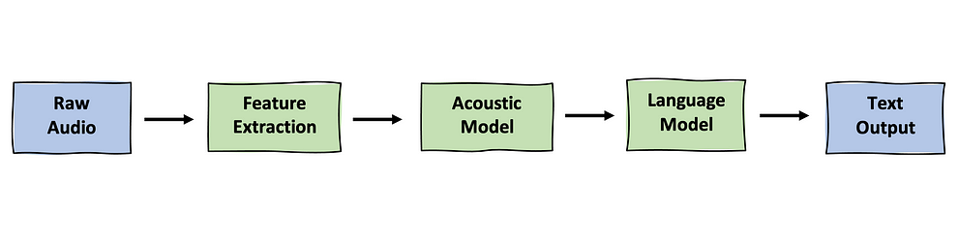
Problem Solution
ASR general Component :
1- Wave: Input audio signal for speech recognition.
2- Feature Extraction: Convert audio to representative feature vectors. (MFCC or Mel-Spectrogram)
3- Acoustic Model: Encodes features to recognize phonetic units.
(extract
4- Language Model: Decodes acoustic output into textual transcription.

Slide 27
Problem Solution
MucT-C dataset Analysis :
MuST-C: Multilingual speech translation corpus.
Size and Quality: Around 463 hours of aligned audio recordings.
Language Pair: English (Audio and transcriptions) and Arabic translations.
 | Train | dev | tst-COMMON | tst-HE
talks | 2412 | 11 | 27 | 12
sentences | 212k | 1k | 2k | 578
words EN | 5m | 24k | 41k | 13k
words AR | 4m | 21k | 36k | 10k
time | 463h15m44s | 2h28m34s | 4h04m39s | 1h26m51s

Slide 28

Problem Solution
Evaluation of the 4 models on MuST-C Dataset.
We use Word Error rate Metric for Evaluation
working at the word level instead of the phoneme level
WER | Model
28.4 | Google API
32.10 | Whisper APIs
28 | Wave2Vec2.0 without Finetune
22.1 | Wave2Vec2.0 with Finetune
Where :
• S is the number of substitutions
• D is the number of deletions
• I is the number of insertions
• C is the number of correct words
• N is the number of words in the
reference (N=S+D+C)

Slide 29
Problem Solution
Machine Translation :
Automated translation of text from one language to another using algorithms and models.
We try 3 models for this task :
1- Google MT Api.
2- Train the same Google Mt From Scratch with MuST-C dataset and Open Subtitles dataset
3- Transformer model from ‘‘Attention is all you need paper’’

Slide 30
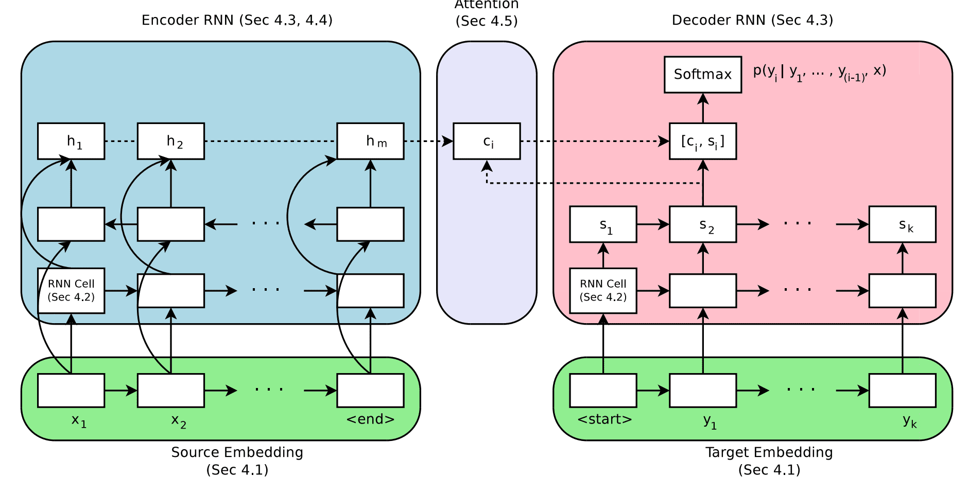
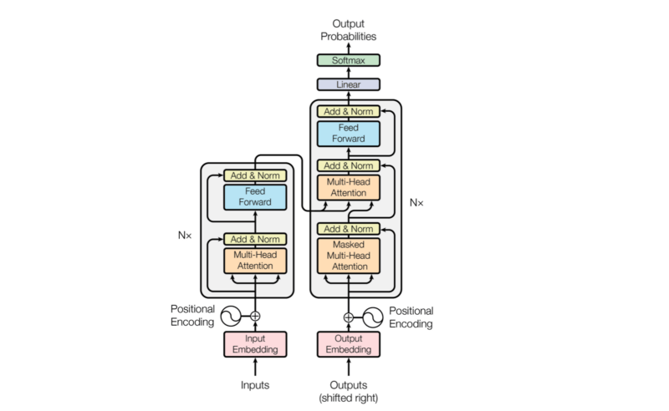
Problem Solution
MT general Component :
1- Source text : Input text for Encoder.
2- Target text : Output from Decoder.
3- Encoder : Convert Source text embedding vectors to representative Context vectors.
4- Decoder : Convert Target text embedding vectors to representative feature vectors and predict the next word given past predicted words and Context vectors.

Slide 31
Problem Solution
Open Subtitles dataset Analysis
Multilingual parallel corpora dataset sourced from movie and TV subtitles.
Size and Quality: Around 30 M sentence alignment units
Language Pair: English and Arabic.
 | Train | dev | test
files | 400k | 11 | 27
sentences | 29.6M | 100k | 200k
tokens | 3.2B | 10M | 50M

Slide 32
Problem Solution
Evaluation of the 3 models on MuST-C and Open subtitles Dataset.
We use BLUE4 score for Evaluation
BLUE4
Open subtitles | MuST-C | Model
0.19 | 0.25 | Google MT API
0.11 |  | Google Mt From Scratch
0.15 |  | Transformer
Evaluation results :
Google API Outperforms : Google API shows better performance compared to the other models.
Limitation of Computing Power : Two models didn't train well due to limited computing resources.
Time for Training : Training process took approximately three months to achieve the reported score.

Slide 33
Problem Solution
Text-to-Speech :
Conversion of written text into spoken audio using synthesized speech technology.
We try 2 models for this task :
1- GTTS model.
2- FastSpeech2 finetuned on Arabic MGB-3 Dataset
We just use pretrained weights because it’s hard to train or finetune this models on our resource

Slide 34
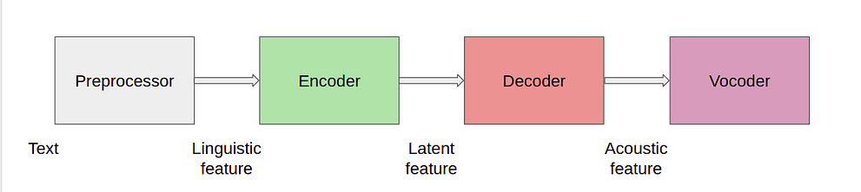
Problem Solution
Text-to-Speech Model Components :
1- Preprocessor : Text normalization and linguistic processing.
2- Encoder : Converts Linguistic feature into intermediate representations.
3-Decoder : Generates acoustic features(Mel-spectrogram) from intermediate representations.
4- Vocoder : Synthesizes speech waveform from acoustic features.

Slide 35
Problem Solution
Synchronization Block
1- Ratio Calculation: Determine the ratio between Arabic and English audio durations.
2- Compression/Decompression: Adjust the Arabic audio duration to synchronize with the English audio.

Slide 36

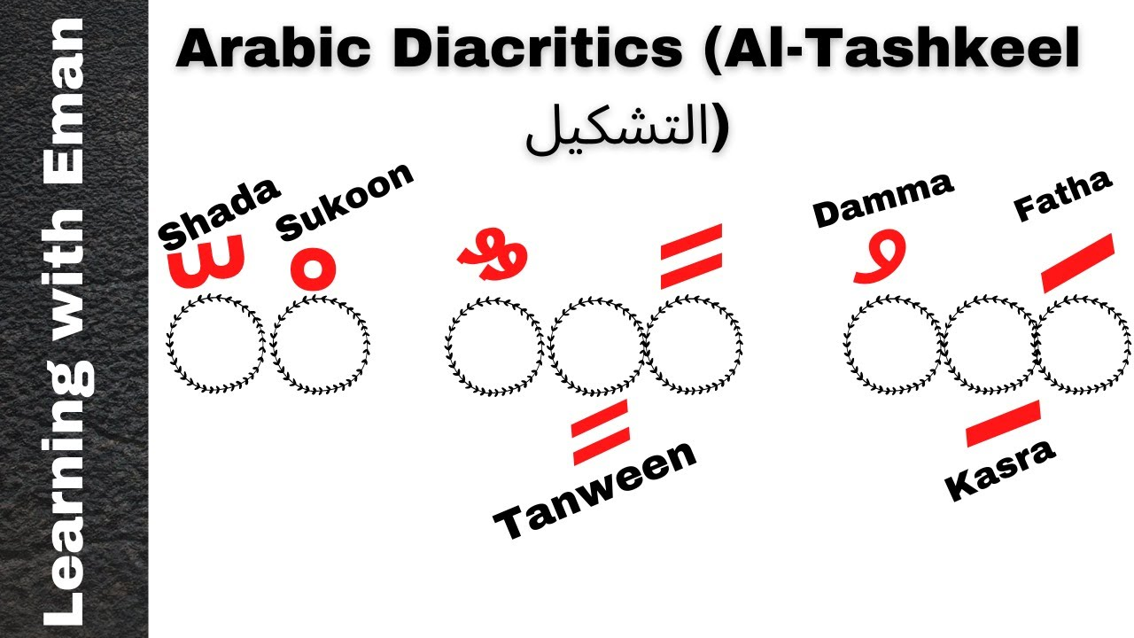
Integration Pipeline:
Identifying challenges in machine translation and
Text-to-Speech modules.
1- Punctuation Impact: Influence of English punctuation on
translation results.
2- Tashkeel Impact: Effect of Arabic diacritical marks
on Text-to-Speech synthesis.

Slide 37

System Architecture
07

Slide 38
System Architecture
Upload video
Firebase
Storage
Replace the EN video with New AR video
Retrieve new video
Retrieve the EN video whose
link is new metadata
Front end
(Flutter App)
Store EN and AR transcript
Firebase
Query Function
Listening to new data
Send EN video
Get AR video
Upload user
and video metadata
Firebase
Fire Store
Server

Slide 39

UI
08

Slide 40
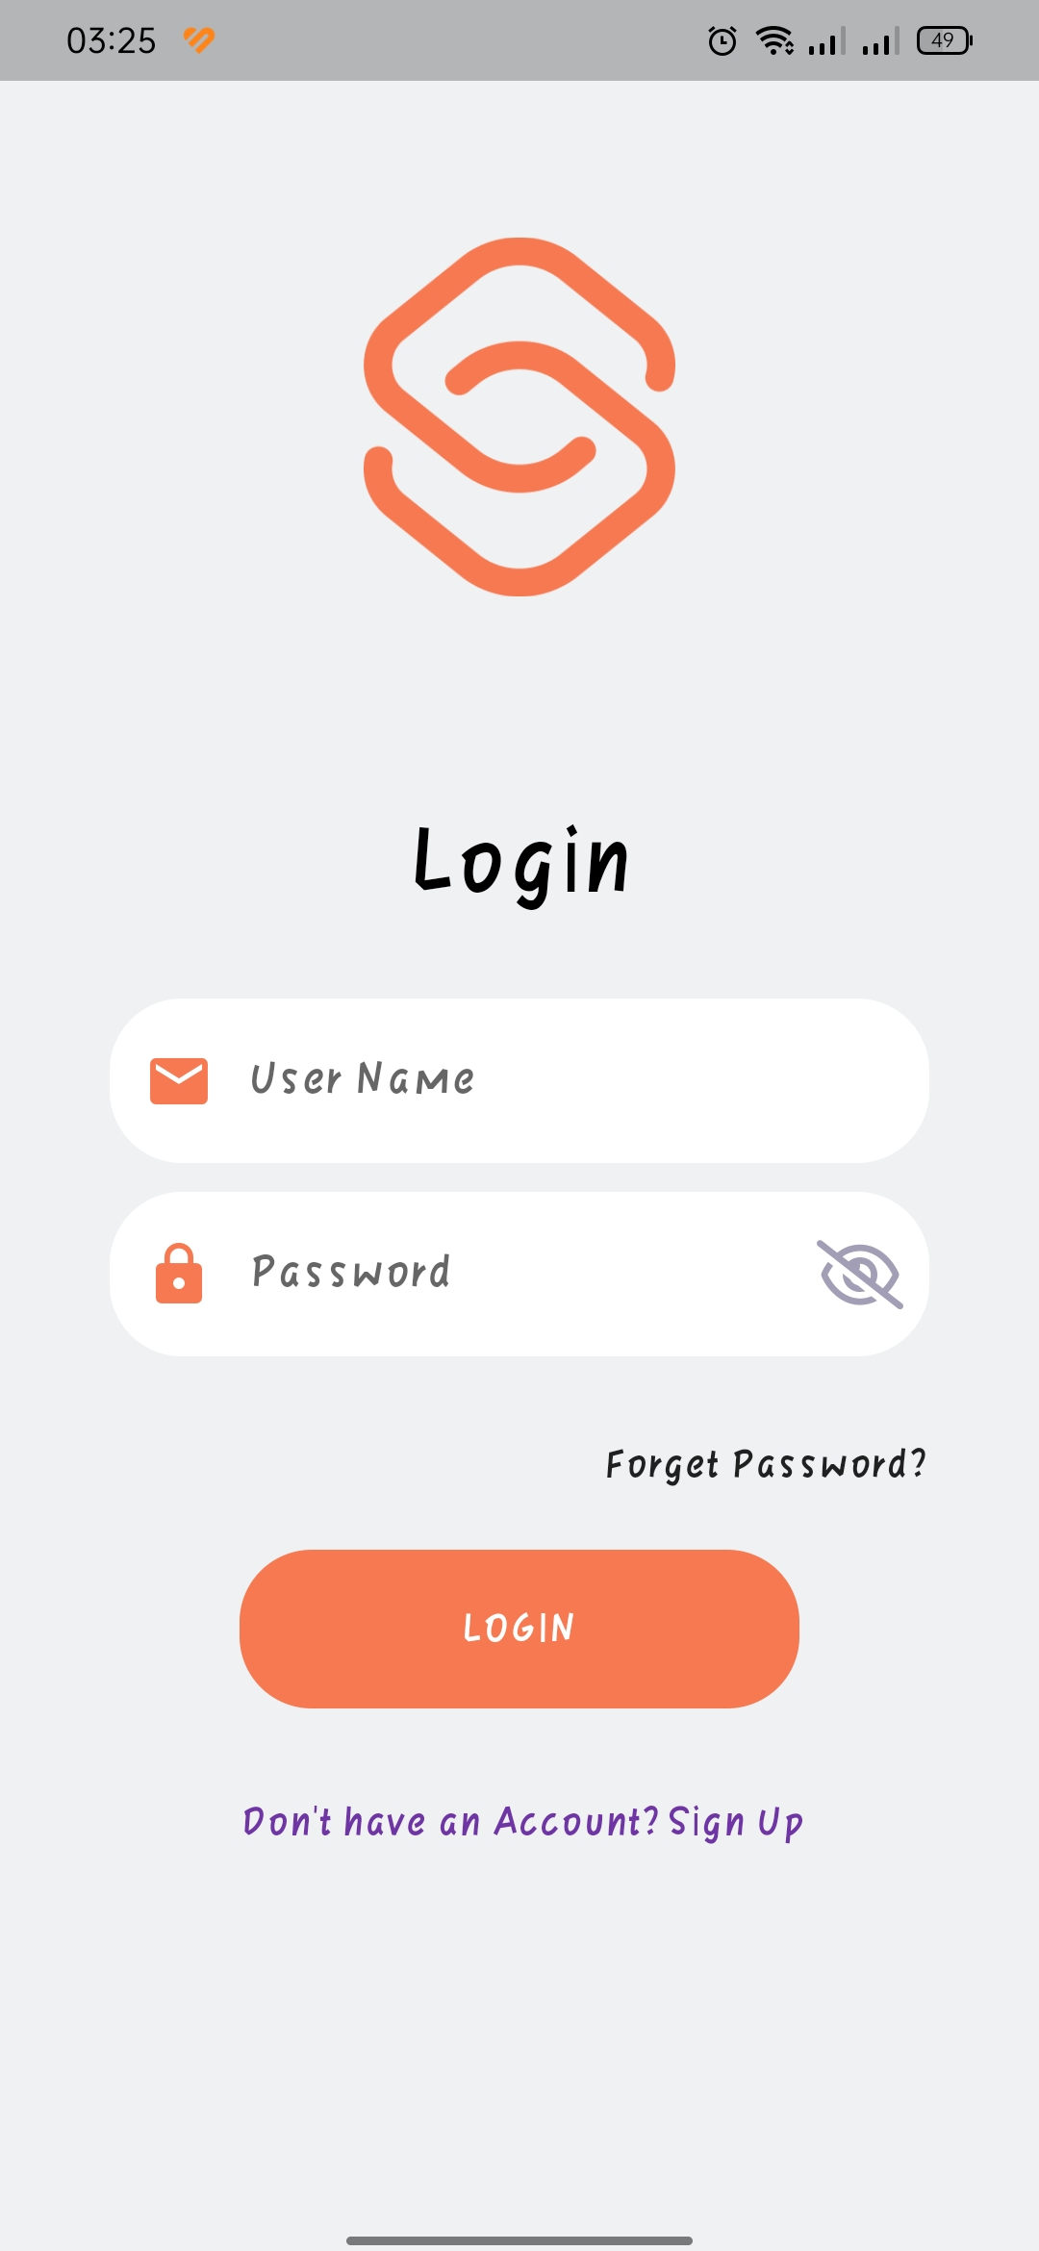
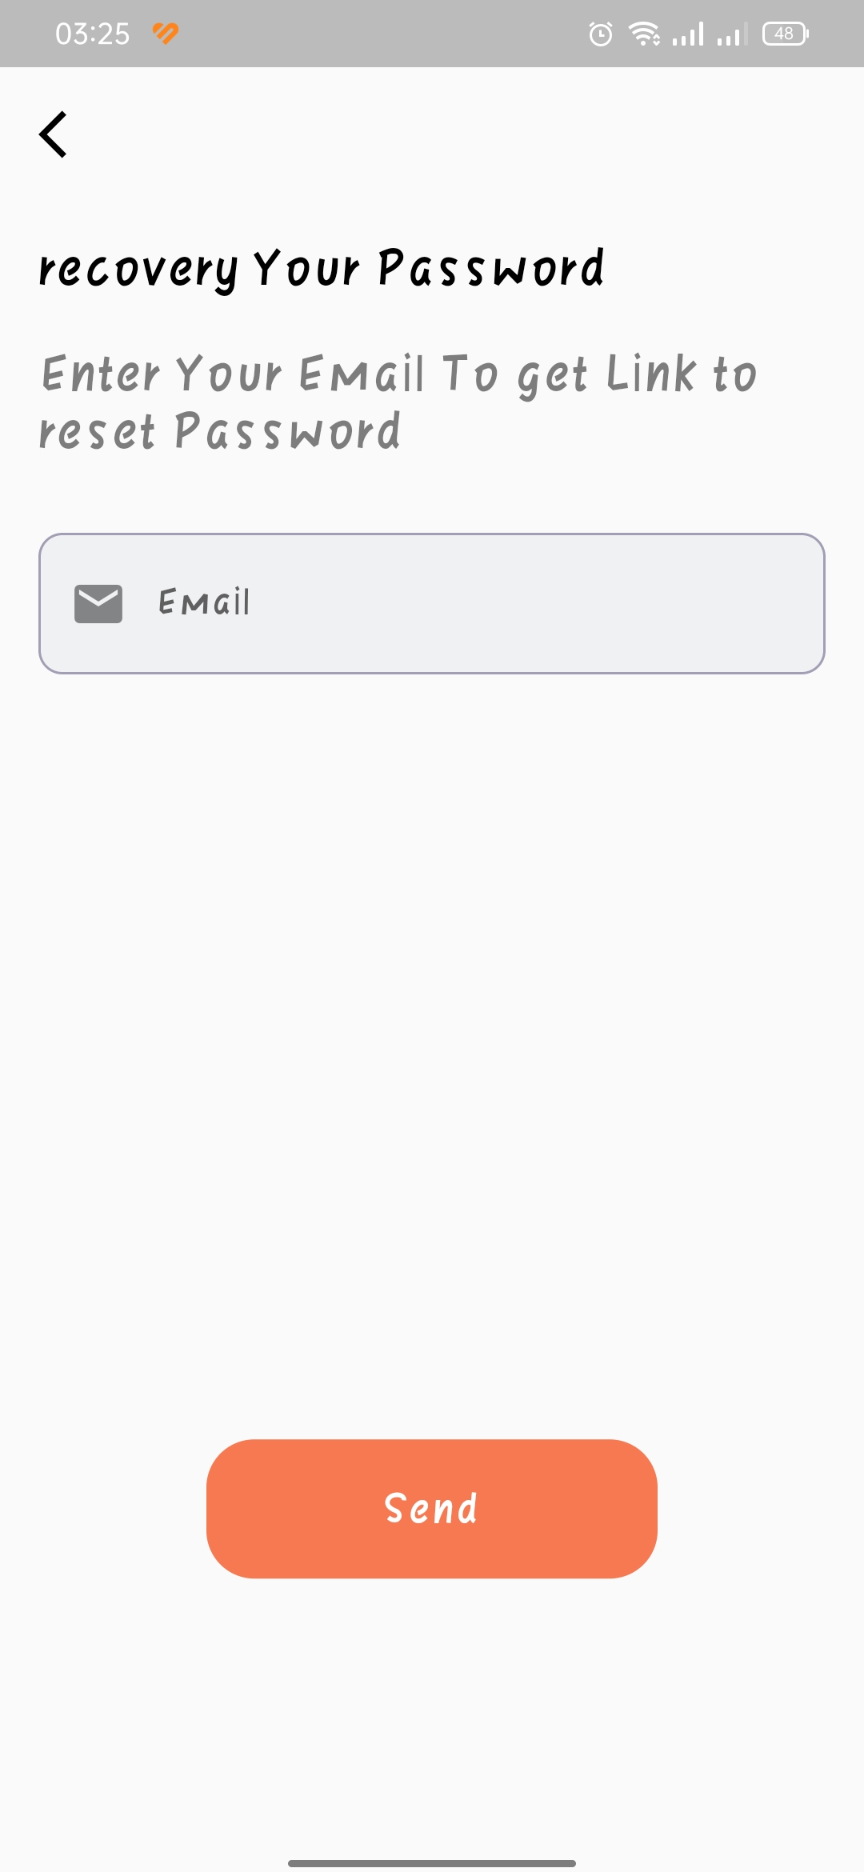
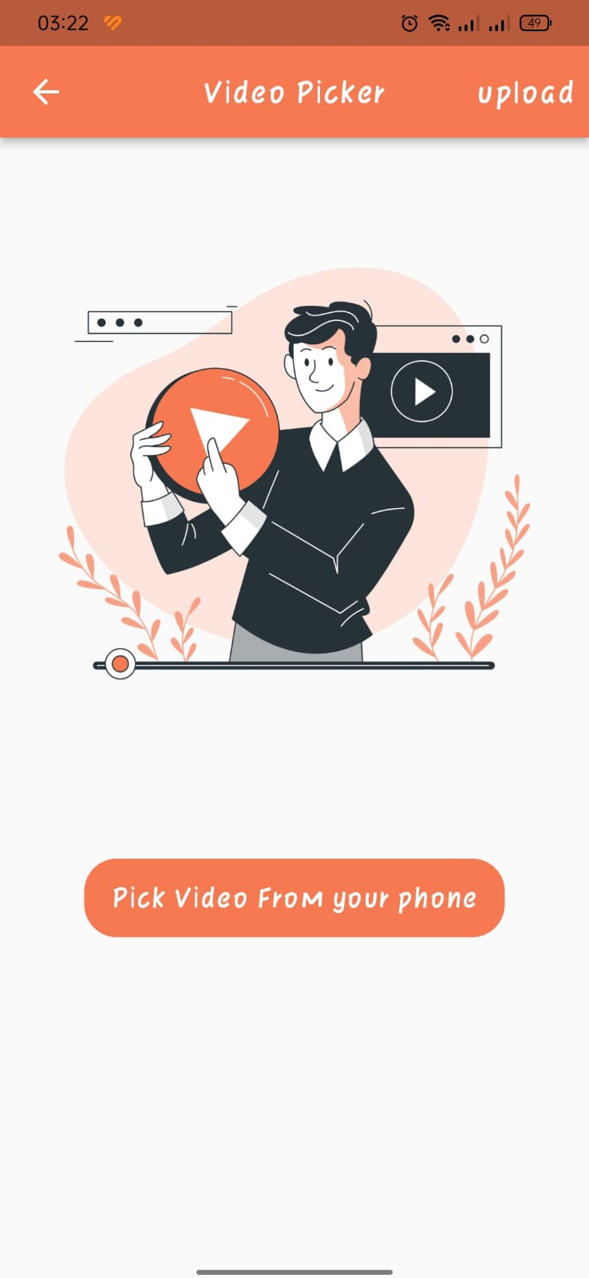
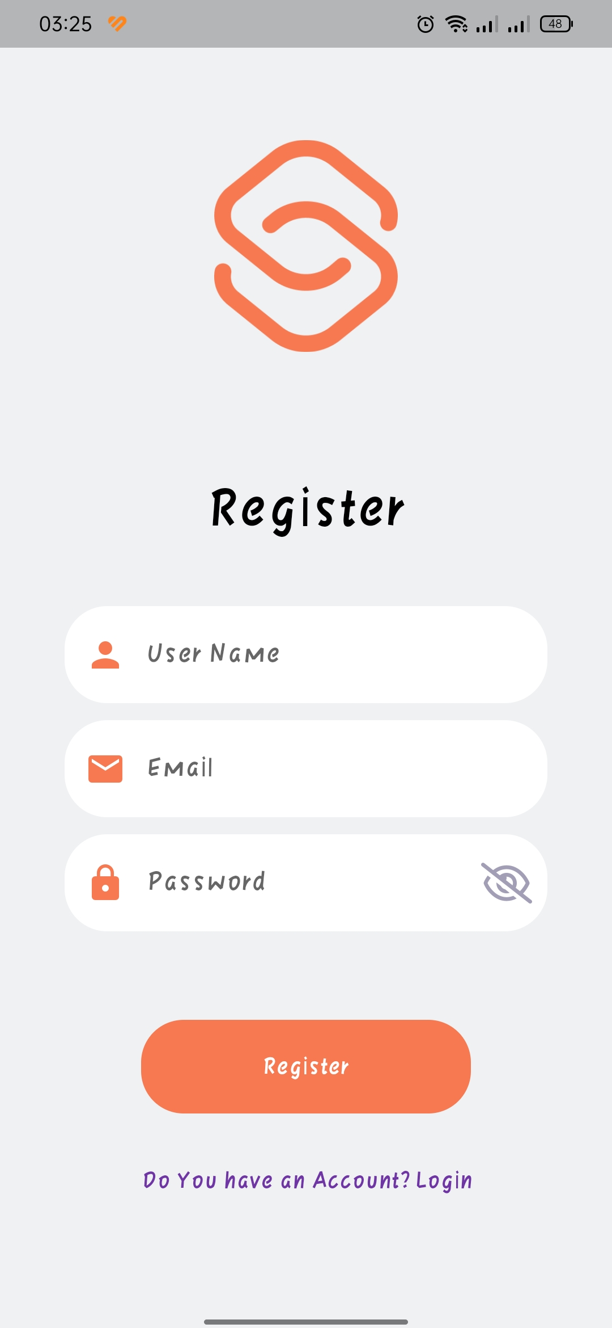
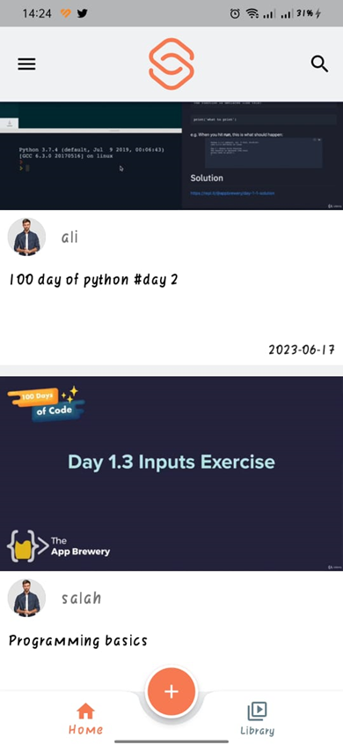

Slide 41
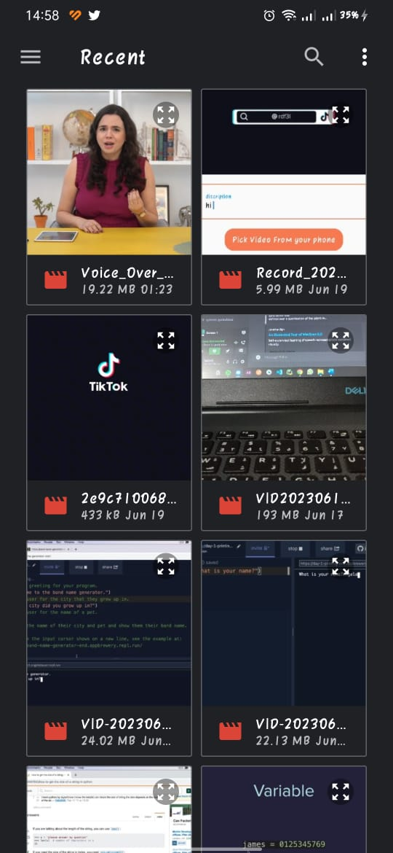
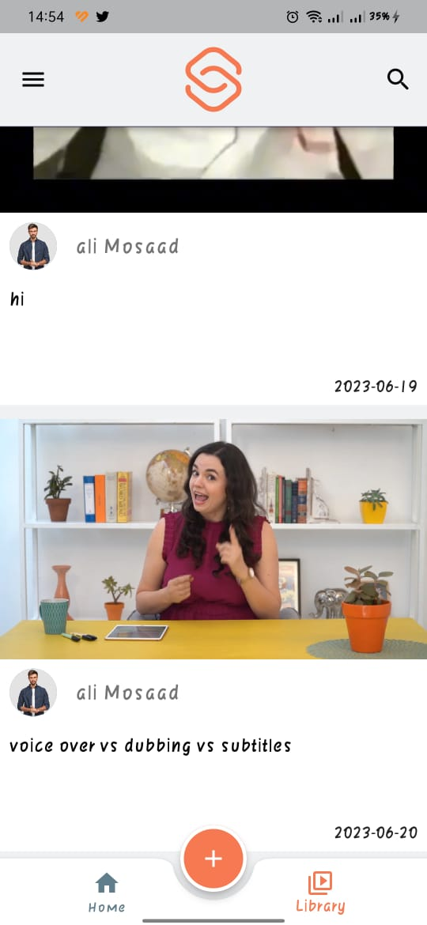
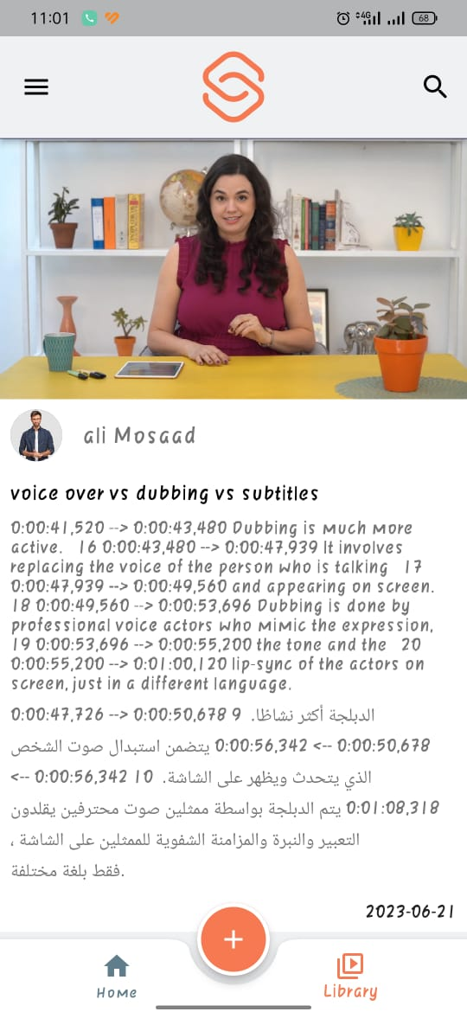
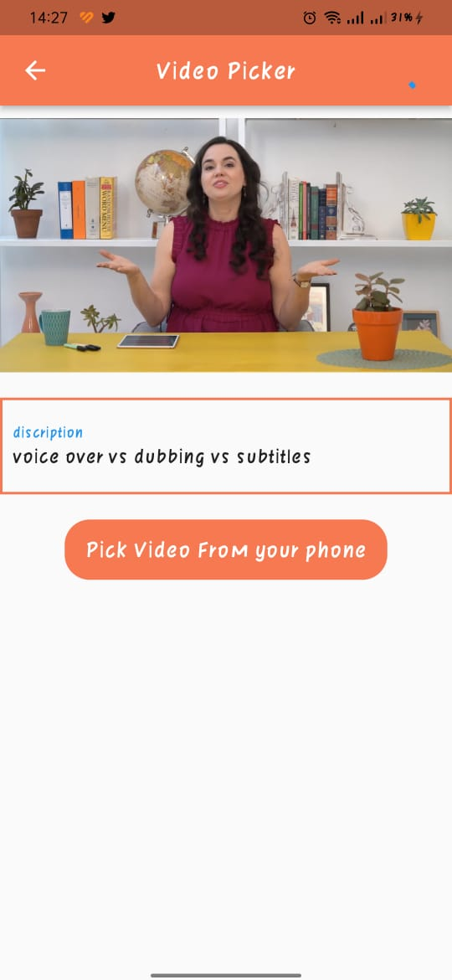
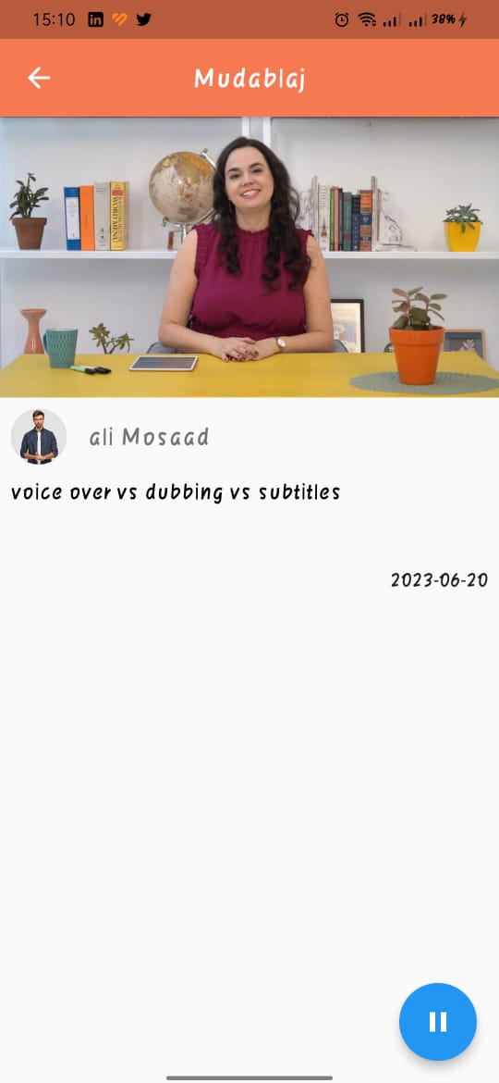

Slide 42
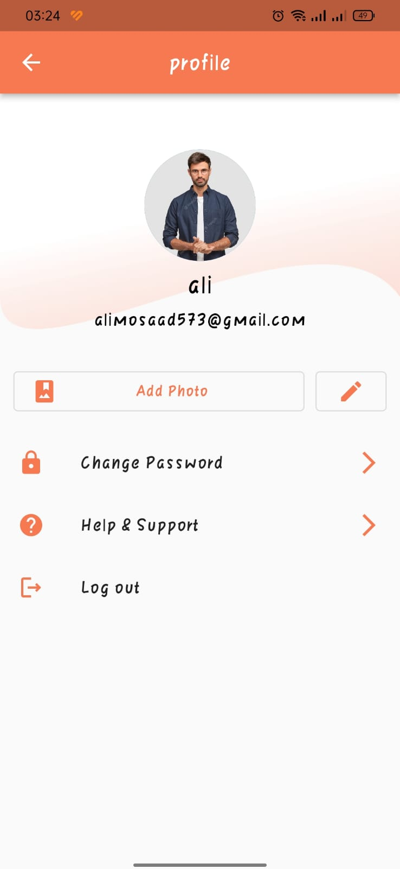
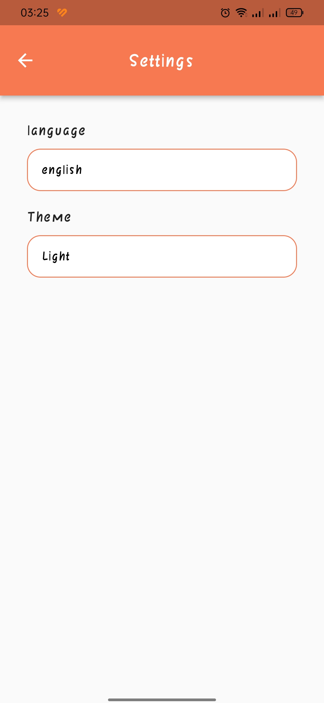
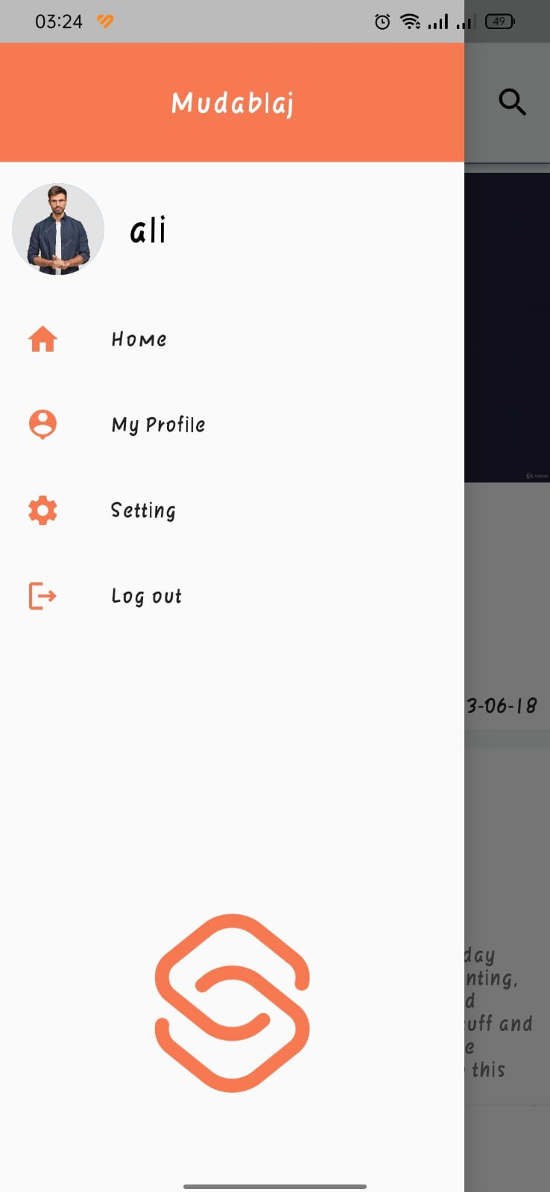
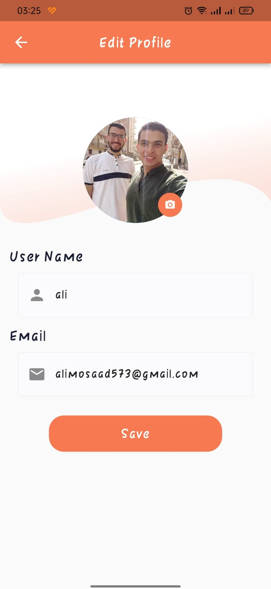

Slide 43
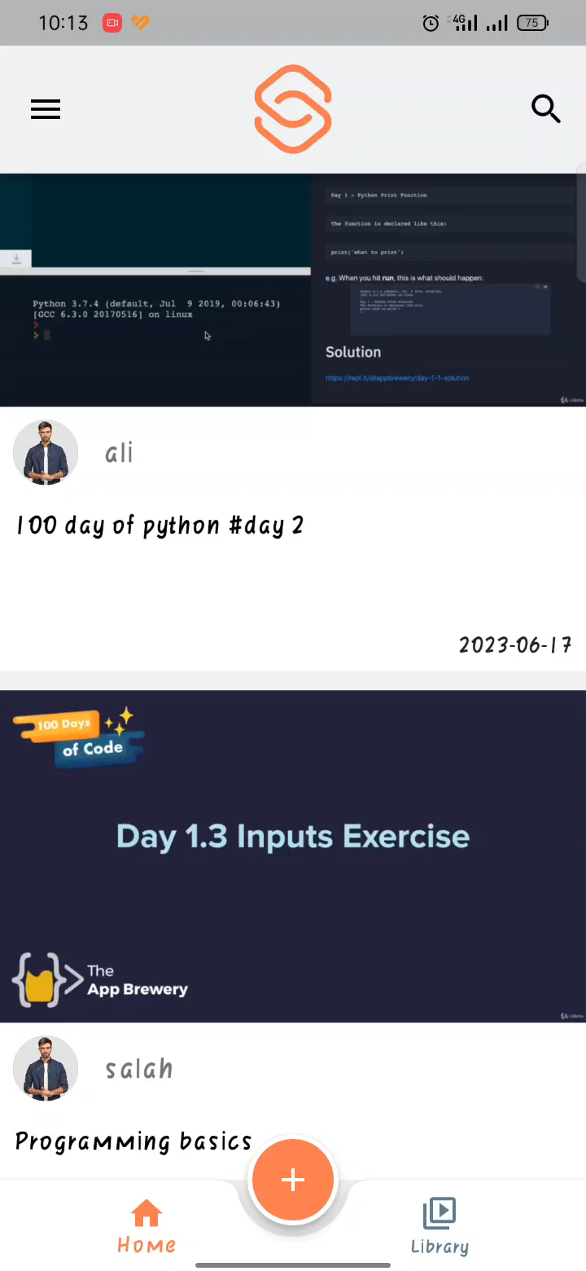
Demo

Slide 44
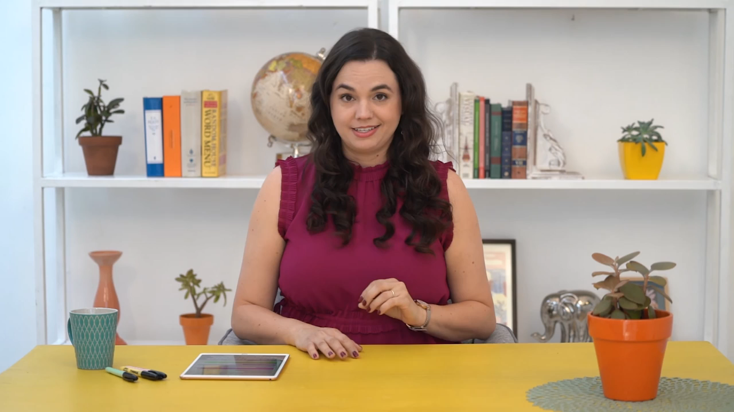
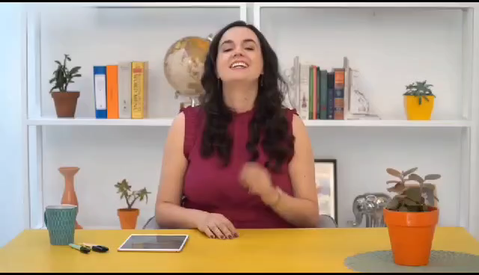
English
Output
Arabic

Slide 45

Competitors
09

Slide 46
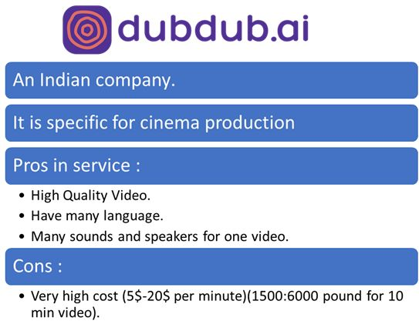
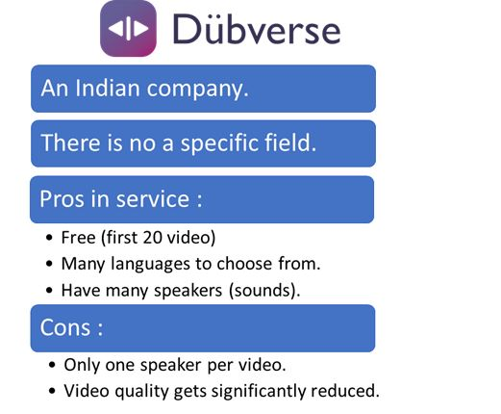
Competitors

Slide 47
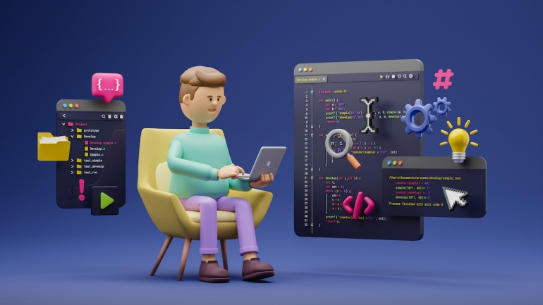
10
Tools

Slide 48








Tools

Slide 49

Benefits
11

Slide 50

Benefits
1. AI Models from Scratch :
- Learn, train, optimize models.
2. Problem-Solving Approach :
- Research, consult, ask experts.
3. Mobile App with Flutter :
- Cross-platform app development.
4. Working with APIs :
- Understand, authenticate, handle
responses.
5. Firebase & Cloud Functions :
- Backend functionality, serverless
computing.

Slide 51

Future work
12

Slide 52

Future Work
Expansion of Supported Languages
Enhancement of Dubbing Precision
Voice Recognition Advancements
Augmentation of Audio Quality
Incorporation of Additional Features
Export website and desktop application
Improve the application by adding new features like dark theme
Improve cascaded system and work on our proposed solution

Slide 53

Conclusion
13

Slide 54

Conclusion
- AI-Based Video Dubbing System :
1. Translates English videos into Arabic.
2. Enhancements Needed :
Expand language support.
Improve dubbing precision.
Enhance voice recognition capabilities.
Improve audio quality.
Add additional features.
3. Goal: Advance capabilities and provide an immersive dubbing experience.
4. Grateful for support and excited about the potential impact.

Slide 55
Thank You

